Slide 1

CodeU Class 5 Welcome!
The class will start shortly
Reproduction and distribution of the presentation deck is prohibited

Slide 2
Agenda for today’s class
Recap of last class
01
02
Homework correction
To refresh our minds!
We’ll revise the hw to understand better
Topics of the day:
03
04
Practice time!
Learn how to code like a pro!
Continuation of While Loop
FOR Loop
Wrap-up
Conclusion
05
06
CodeU Robot
Summary of what we’ve learned today
homework and questions

Slide 3

First Exercise: Guessing Game!
01
In the first exercise, we will create a Guessing Game where we must guess the right number between 1 and 10 using the WHILE Loop and the Random Module.
Random Module: The Random module allows to randomly select a value. In this case, the computer will randomly choose a number between 1 and 10.
You must import the Random Module
You then have to create a variable for the random number using random.randrange(First Number, Last Number)
Ask the user to choose a number between 1 and 10 using Input()
Create the WHILE Loop that will end once the user’s answer is the same as the random number determined by random.randrange()
Remember that the loop repeats the question until the answer is correct!

Slide 4

Metaverse Guessing Contest!
02
You must import the Random Module
You then have to create variables for the number of tries (tries) and for the random number using random.randrange(First Number, Last Number)
Create an input() variable where the user is asked to call the Radio Station
Create a conditional (IF) where if the user’s input is “call”, it prints “Thank you for calling”
Create a WHILE Loop inside the conditional.
Inside the Loop, create a conditional where if their answer is correct, it prints “Congratulations!! You now have access to the METAVERSE :)”. If the answer is incorrect, they have one less try.
This process repeats until they’ve used 3 tries!
Description
The Metaverse, an online virtual reality environment, is ready for more users! They’ve asked you to create a contest where the prize is a ticket to the Metaverse! Users will have to call in to the Metaverse Radio Station and guess the correct number. They are only allowed 3 tries!

Slide 5
Introduction to FOR Loop!
03
What is For?
With CodeU, we’ll only be seeing the FOR Loop using Lists, Strings, and Sets
A "For" Loop is used to repeat a specific block of code a known number of times.
For example, if we want to check the grade of every student in a class of 20 students, we loop from 1 to 20. When the number of times is not known before hand, we use a "While" loop.
What can we use?
Syntax Example
Students = [“Sahil”, “Clara”, “Giuseppe”, “Oliver”]
for i in students: print(i)
Result: This will print every student in the list, starting with the first one.
To determine the “number of times” the loop will be repeated, we can use Lists, Strings, a Dictionary, a tuple and a set.

Slide 6
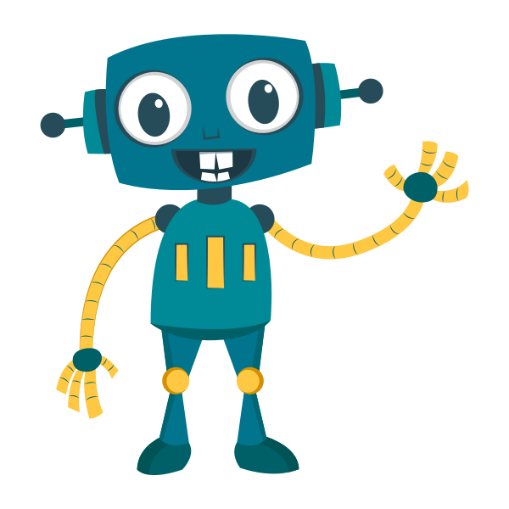
We want to print all elements of a list. This method works, however it is not ideal if our list contains many elements.
fruits = ["apple", "banana", "strawberry", "mango"]
print(fruits[0])
print(fruits[1])
print(fruits[2])
Instead, we use FOR loop to retrieve the elements in a list. This is crucial for very long lists!
fruits = ["apple", "banana", "strawberry", "mango"]
for i in fruits:
print(i)

Slide 7
Let’s practice!
03
01
Introduction to range()
for i in range(5):
print(i)
Result: This will repeat the loop a total of 5 times. On the first loop, i = 0. on the second loop, i = 1. This goes on until i = 5, which is where the loop stops.
Finding each element of a String (word, sequence of letters, etc.)
name = "Sebastian"
for i in name:
print(i)
range(START, STOP, STEP)
02
04
Find the SUM of all the elements in a list
numbers = [1, 4, 8, 12]
total = 0
for i in numbers:
total += i
print(total)
The first value is the start of the range, the second is the end of the range, and the third is the increment of the step.
for i in range(5,15,3):
print(i)

Slide 8
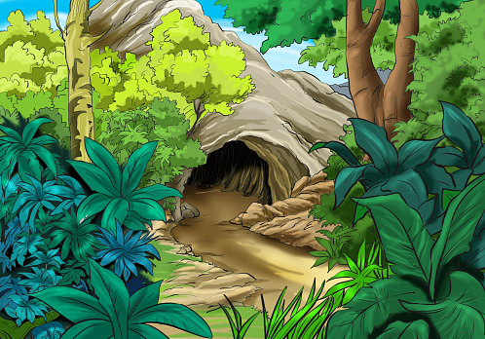
Hidden Passage in the Hills!
Description
During a hike, you come across what seems to be a secret passage at the bottom of a hill in the forest. Unfortunately, there are doors that don’t allow you to enter. You see next to the door, on the wall, there is a writing that says ”You must find the sum of all numbers that come before 100 to enter!”.
You must create a code that will allow you to retrieve all the numbers between 1 and 100. You will then have to add them individually to a variable called “sum”.
Once you have the answer, enter it where the system asks you to insert your answer. If it is correct, you may pass! If not, there is most likely an issue in your code…So fix it!

Slide 9
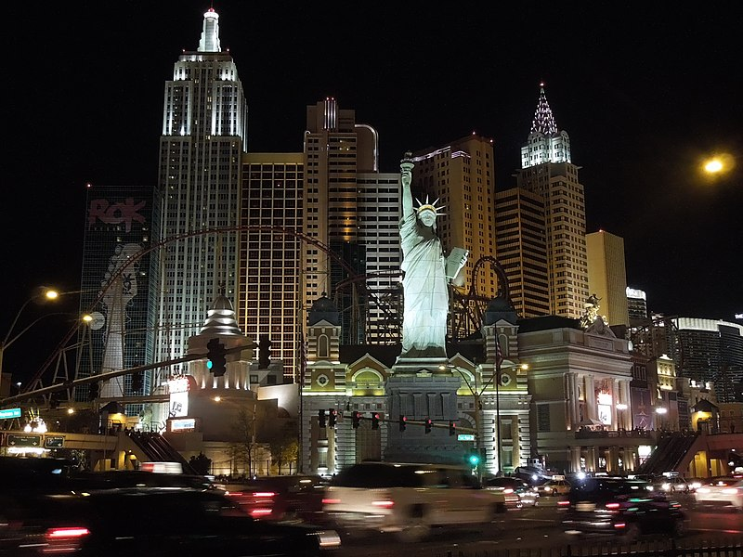
Homework: Will the elevator break?
Homework Description
A famous hotel in New York City has a faulty and very weak elevator. They've held back on fixing it because they are lazy and don't want to spend money.
By precaution, the can only allow 8 people on the elevator at a time.
A group of tourists arrive at the hotel. They all book a room for the night. Since they're all together, they decide to go up at the same time. We have the weight of each person in pounds: 208, 200, 350, 500, 127, 145, 134, 900
The elevator can only hold a MAXIMUM of 2500 pounds. You must determine if the elevator will break if they all use it at the same time!
1
You must create a list containing the weight of every person in the group of tourists.
4
Print() the total weight once the Loop is finished.
2
You will then define a variable for the total weight. This is where you’ll add the weight of every person.
5
Print() the number of people on the elevator using a list method.
3
You must use a FOR Loop to navigate the list you created.

Slide 10
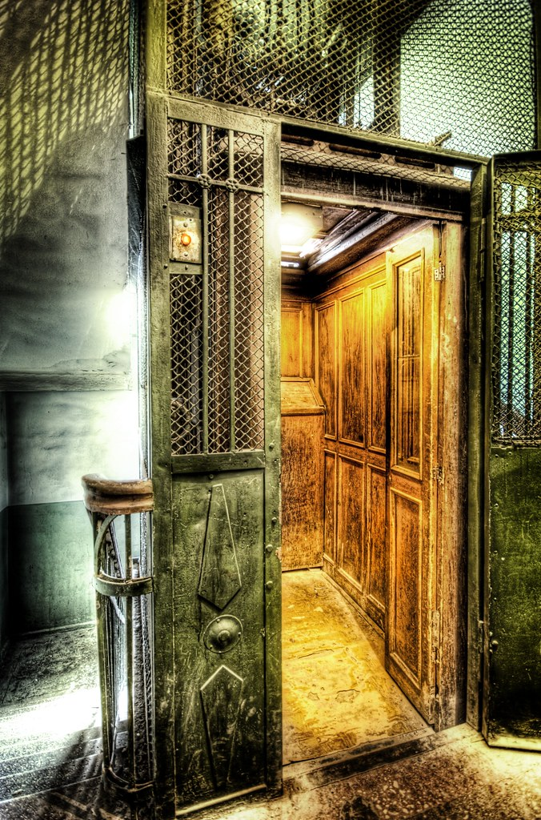
Homework Solution: Will the elevator break?
1
Build the list of tourists
weight = [208, 200, 350, 500, 127, 145, 134, 900]
Create the variable where you will be adding the weight of every person
weight_total = 0
Create the FOR Loop
for i in weight:
weight += i
Print the results
participants = len(weight)
print(str(participants) + " participants weigh a total of " + str(weight_total))
This Photo by Unknown Author is licensed under CC BY-SA-NC

Slide 11



Thank you!
Does anyone have any questions?
Next class: class 6!
Phone:
(438) 391-9106
Please contact us to make any change in the schedule for the next class.
Email:
siva.sri14@hotmail.com
hello@codeu.ca
Website:
https://www.codeu.ca/
Reproduction and distribution of the presentation deck is prohibited

